Slide 1
Memory Management and Java

Slide 2
Why do you care?
Java actually handles most of the memory management for you so why care?
Other languages don’t do memory management- the programmers do
If you do have memory issues a basic understanding can help you resolve them.

Slide 3
Memory Profiling Tools
Stackify
Jprofiler (requires License)
Eclipse MAT (freely available- web instructions available)
YourKit
NetBeans Profiler (add on to NetBeans)
Java Mission Control

Slide 4

JVM Memory Structure
The JVM Memory is divided in to 3 parts as shown in the below image. In our applications we are most concerned about the Heap Memory. If the defaults aren’t working, we can input this value to JVM using the parameters,
-Xmx<size> – to set the maximum Java heap size -Xms<size> – to set the initial Java heap size

Slide 5
Non-Heap memory
The non-Heap memory stores per-class structures such as :
runtime constant pool
field and method data
Code for methods and constructors
Interned Strings
Size will be dependent upon the size of your program. You don’t really control this except as you create your .java files.

Slide 6
Stack vs Heap
The basic difference between stack and heap is the life cycle of the values
Stack values only exist within the scope of a method, they are discarded at end of a method
Heap values exist until explicitly destructed. – most “memory leaks” exist in the Heap usage.

Slide 7
Troubleshooting Memory Leaks
Oracle has a great article on trouble shooting memory leaks in your Java program
http://www.oracle.com/technetwork/java/javase/memleaks-137499.html

Slide 8
Java Memory Model
A lot of literature on Java memory model is related to making your program thread safe
By using locks/conditions, synchronized and thread-safe collections, you are working within the memory model.
We will discuss this more in Multithreading after Midterm

Slide 9
Garbage Collection
Most Java memory management issues relate to optimizing heap size and making garbage collection more efficient.

Slide 10
What does gc do?
The Java garbage collector monitors allocated memory (new keyword) to make sure it is being used and referred to.
When an object created by new, is no longer used or referenced, the gc frees (deallocates) the memory for use by other objects.

Slide 11
Issues with GC
The GC is another thread running in the background of your program
It tracks all objects including ones being used
It frees memory effectively, but can create performance issues in your code.

Slide 12
GC Roots
The GC keeps a tree (data structure) of objects used in the program.
Special objects called roots are always reachable. These include:
Local variables
Active Java threads
Static variables
JNI references

Slide 13
What does GC do?
The GC runs periodically and does a “mark-and-sweep algorithm”
Look at all objects references in object tree and marks objects as “alive” (referred to) or “dead”
Reclaims all heap memory not occupied by “alive” objects. (marks that memory as free)

Slide 14
Why Garbage Collect?
Classic memory leaks (programs that use more and more memory the longer they run) are caused by unreachable, but not freed (disposed) memory.
GC is designed to remove that cause of memory leaks.
If program continually refers to objects it is not using, they will not be garbage collected.

Slide 15
Choosing Data Structures

Slide 16
Executing Time
Suppose two algorithms perform the same task such as search (linear search vs. binary search) and sorting (selection sort vs. insertion sort). Which one is better? One possible approach to answer this question is to implement these algorithms in Java and run the programs to get execution time. But there are two problems for this approach:
First, there are many tasks running concurrently on a computer. The execution time of a particular program is dependent on the system load.
Second, the execution time is dependent on specific input. Consider linear search and binary search for example. If an element to be searched happens to be the first in the list, linear search will find the element quicker than binary search.

Slide 17
Growth Rate
It is often useful to see how the execution time of an algorithm changes with the size of the input
This is sometimes called the “growth rate” of an algorithm.

Slide 18
Big O Notation
Computer scientists use Big O notation to show that execution growth rate.
It is an abbreviation for “Order of Magnitude”
Using this notation, the complexity of the linear search algorithm is O(n), pronounced “order of n”

Slide 19
Best, Worst and Average Cases
In addition to Big O, we often worry about what is the best-case execution time or more importantly, worst-case.
Worst-case analysis is very useful- your algorithm will never run slower than the worst case.
Average case analysis is ideal, but programs rarely run exactly average

Slide 20
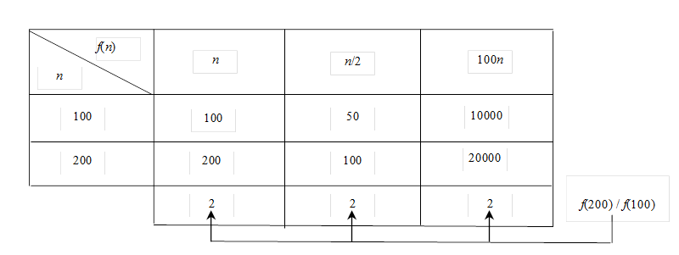
Ignoring Multiplicative Constants
The linear search algorithm requires n comparisons in the worst-case and n/2 comparisons in the average-case. Using the Big O notation, both cases require O(n) time. The multiplicative constant (1/2) can be omitted. Algorithm analysis is focused on growth rate. The multiplicative constants have no impact on growth rates. The growth rate for n/2 or 100n is the same as n, i.e., O(n) = O(n/2) = O(100n).

Slide 21
Examples: Determining Big-O
Repetition
Sequence
Selection

Slide 22
Repetition: Simple Loops
for (i = 1; i <= n; i++) {
k = k + 5;
}
executed
n times
constant time
Time Complexity
T(n) = (a constant c) * n = cn = O(n)
Ignore multiplicative constants (e.g., “c”).

Slide 23
Repetition: Nested Loops
for (i = 1; i <= n; i++) {
for (j = 1; j <= n; j++) {
k = k + i + j;
}
}
executed
n times
inner loop
executed
n times
constant time
Time Complexity
T(n) = (a constant c) * n * n = cn² = O(n²)
Ignore multiplicative constants (e.g., “c”).

Slide 24
Repetition: Nested Loops
for (i = 1; i <= n; i++) {
for (j = 1; j <= i; j++) {
k = k + i + j;
}
}
executed
n times
inner loop
executed
i times
constant time
Time Complexity
T(n) = c + 2c + 3c + 4c + … + nc = cn(n+1)/2 = (c/2)n² + (c/2)n = O(n²)
Ignore non-dominating terms
Ignore multiplicative constants

Slide 25
Repetition: Nested Loops
for (i = 1; i <= n; i++) {
for (j = 1; j <= 20; j++) {
k = k + i + j;
}
}
executed
n times
inner loop
executed
20 times
constant time
Time Complexity
T(n) = 20 * c * n = O(n)
Ignore multiplicative constants (e.g., 20*c)

Slide 26
Sequence
for (j = 1; j <= 10; j++) {
k = k + 4;
}
executed
10 times
for (i = 1; i <= n; i++) {
for (j = 1; j <= 20; j++) {
k = k + i + j;
}
}
executed
n times
inner loop
executed
20 times
Time Complexity
T(n) = c *10 + 20 * c * n = O(n)

Slide 27
Selection
O(n)
if (list.contains(e)) {
System.out.println(e);
}
else
for (Object t: list) {
System.out.println(t);
}
Let n be
list.size().
Executed
n times.
Time Complexity
T(n) = test time + worst-case (if, else)
= O(n) + O(n)
= O(n)

Slide 28
Constant Time
Big O notation estimates estimation time in relation to input size
If time is not related to input size, the algorithm is said to take constant time with the notation O(1)
For example, retrieving an array element at a specific takes constant time. The size of the array does not impact this at all.

Slide 29
Logarithmic Time
The complexity of the binary search algorithm is O(log(n))
This is called logarithmic algorithm.
Logarithmic algorithms grow slowly as the problem size increases
Squaring the input size, only doubles the execution time.

Slide 30
Quadratic Time
The selection sort algorithm has a big O of O(n*n).
It grows quickly as the size increases.
If you double input size, the execution time is quadrupled.
Nested loops are often quadratic.

Slide 31
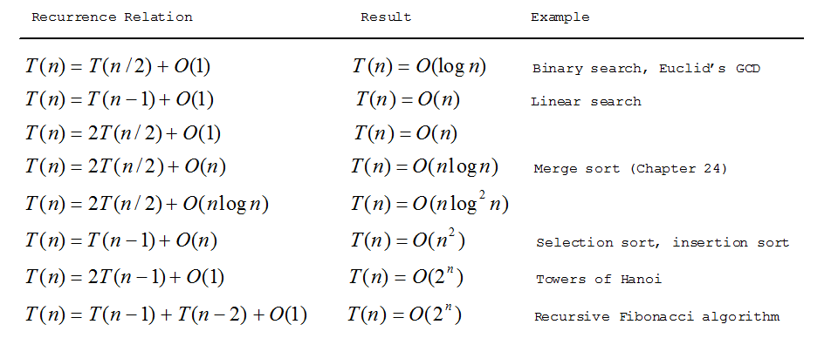
Common Algorithms

Slide 32







Comparing Common Growth Functions
Constant time
Logarithmic time
Linear time
Log-linear time
Quadratic time
Cubic time
Exponential time

Slide 33
Compare Various Techniques
Finding Prime Numbers
Brute force
PrimeNumber.java
PrimeNumbers.java
Check possible divisors up to Math.sqrt(n)
EfficientPrimeNumbers.java
Check possible prime divisors up to Math.sqrt(n)
SieveOrEratosthenes.java

Slide 34
Practical Considerations
Big O is a good theoretical estimate of efficiency.
BUT, two algorithms of same time complexity are not equally efficient.
Use good judgment when choosing algorithms.
When data size is very small, Big O has no meaning.

